Slide 1
Signature Forgery Detection Using Siamese Network: One Shot Learning
Done By:
200240128012 Kanumuri Sri Naga Sai Ajith
200240128015 Mohit Kumar
200240128018 Padmaja Phanse
200240128023 Satbhai Aniket Bharatrao
200240128033 V Raghavendra Krishna Srujan
Supervised By:
Ms. Swapna E

Slide 2
Abstract
Objective
Siamese Network
One Shot Learning
Loss Functions
Data Loading
Preprocessing
Model Building
Hyperparameter Tuning
Model Evaluation
Inference
Why not use vanilla CNN?
Conclusion
Contents

Slide 3
Abstract
Siamese Network
Data Loading and Preprocessing
Model Building
Hyperparameter Tuning
Model Evaluation
Inference

Slide 4
Objective
To create a model which detects signature forgery. It should work for unseen data as well.
Deploy the model and use it in real time signature forgery detection.

Slide 5
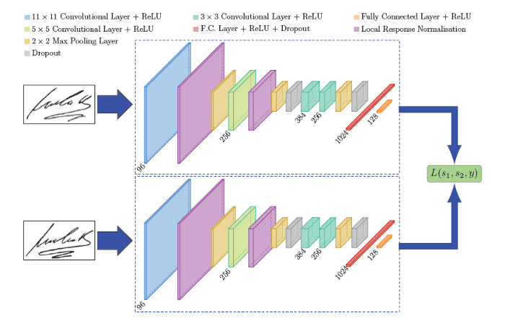
Siamese Network

Slide 6
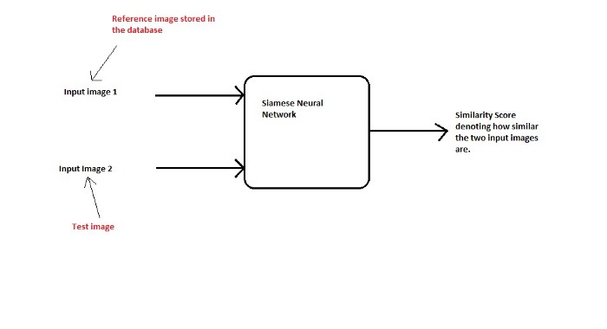
One shot learning

Slide 7
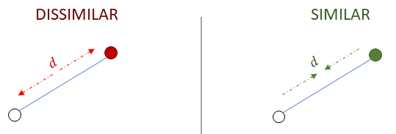
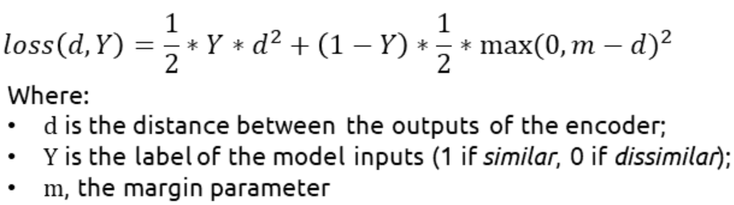
Loss Functions
Contrastive Loss

Slide 8
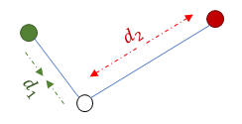
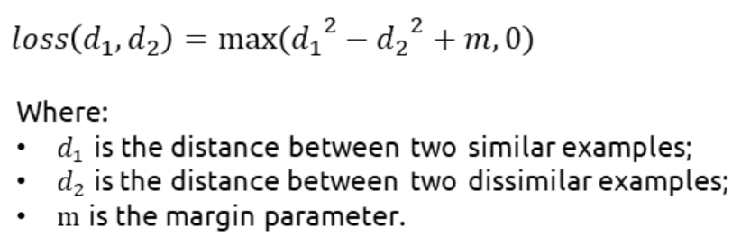
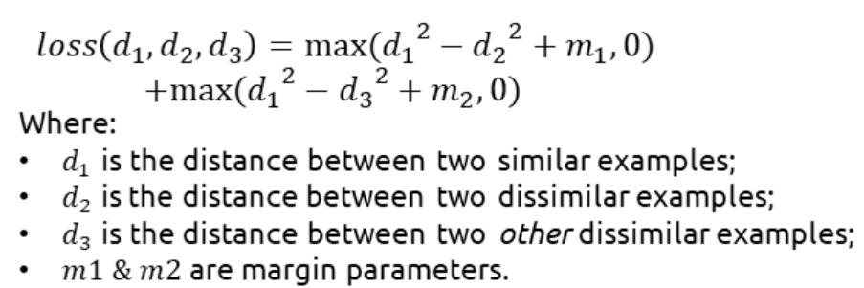
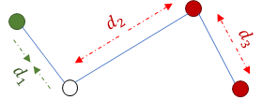
Triplet Loss
Quadruplet Loss

Slide 9
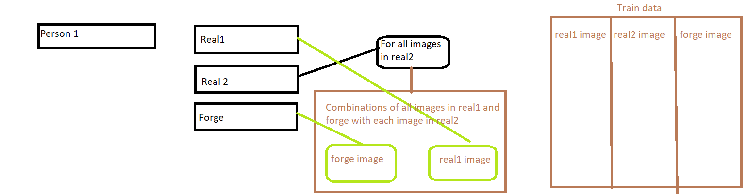
Data Loading
Data is rearranged such that for each person genuine images are divided in two folders Real1 & Real2, forged images are kept in Forge folder.

Slide 10
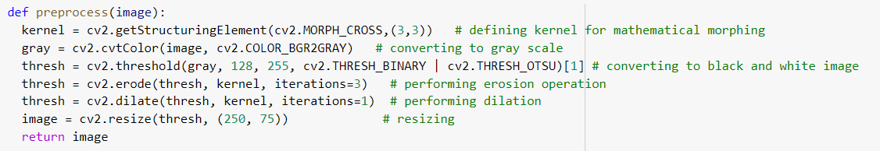
Preprocessing
Image size is reduced to a large extent without significant loss of information.
Infact, mathematical morphology improved the statistical significance of the model.
Initial size of images varies with size around: (250,850,3)

Slide 11
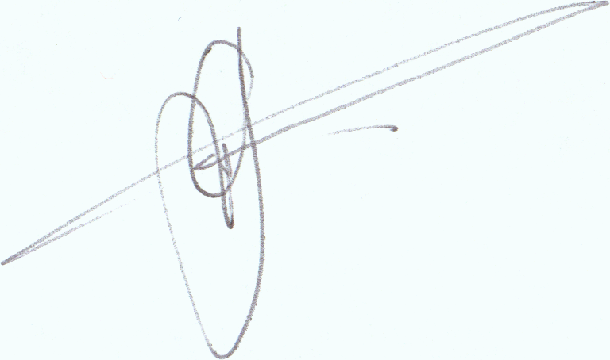
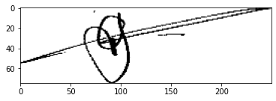
Before Preprocessing:
After Preprocessing:

Slide 12
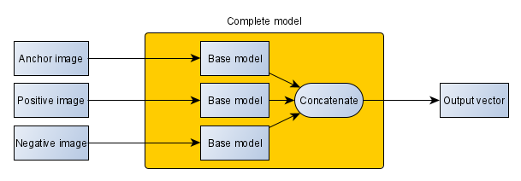
Model Building
Base model - Sequential API
Complete model - Functional API
A tensorflow dataset object is used to feed the training data to the model.
Notes:
Training time with GPU - 15-20 mins
Without GPU - 2-3 hrs

Slide 13
Hyperparameter Tuning
Aniket
Batch Size | Epochs | Model | Optimizer | kernel_initializer | Triplet Loss Margin | Training Loss | Validation Loss
64 | 15 | C 128(5), BN, MP(3), C 256(5), BN, MP(3), C 256(3), BN, MP(3), Drop 0.2, F, D 512 | Adam(0.0005) | he_normal | 500 | 0.60 | 13.37
64 | 20 | C 128(5), BN, MP(3), C 256(5), BN, MP(3), C 256(3), BN, MP(3), Drop 0.2, F, D 512 | Adam(0.0005) | he_normal | 500 | 0.04 | 5.58
64 | 21 | C 128(5), BN, MP(3), C 256(5), BN, MP(3), C 256(3), BN, MP(3), Drop 0.2, F, D 512 | Adam(0.0005) | he_normal | 500 | 0.06 | 4.40
Srujan
Batch Size | Epochs | Model | Optimizer | Others | Triplet Loss Margin | Training Loss | Validation Loss
128 | 25 | 64,128,256,256,f,1024 | 0.0001 | 0.1 | 500 | 0.48 | 16
128 | 25 | 64,128,256,256,f,1024 | 0.0001 | 0.1 | 500 | 1 | 13
64 | 25 | 64,128,256,256.f,1024 | 0.0005 | 0.2 | 500 | 2 | 10

Slide 14
Mohit
Batch Size | Epochs | Model | Optimizer | Others | Triplet Loss Margin | Training Loss | Validation Loss
32 | 10 | 64(5,5)BN,,MP(2,2),128(5,5),BN,MP(2,2),256(5,5),BN,MP(2,2),256(5,5),BN,MP(2,2),F,512(dense) | Adam(0.001) | Henorm initializer,batch_normalization | 1000 | 31.9653 | 373.5139
64 | 15 | 64(5,5),BN,MP,128(3,3),BN,MP,128(3,3),BN,MP,256(3,3),BN,MP,F,2048(dense) | ADAM(0.0001) | Henorm,kernal_regularizer(L2),with batch normalization | 1000 | 77.335 | 495.49
64 | 25 | 64(5,5),BN,MP,128(5,5),BN,MP,DP(.2),256(5,5),BN,MP,DP(0.2)256(5,5),BN,MP,F,1024(dense) | Adam(0.0005) | Henorm initializer,batch_normalization | 500 | 2.3 | 11.21
Ajith
Batch Size | Epochs | Model | Optimizer | kernel_initializer | Triplet Loss Margin | Training Loss | Validation Loss
64 | 10 | C64-BN-MP-C128-BN-MP-DR0.2-C256-BN-MP-DR0.2-C256-BN-MP-F-D1024 | Adam(0.0005) | he_normal | 500 | 7.3909 | 45.2027
64 | 15 | C64-BN-MP-C128-BN-MP-DR0.2-C256-BN-MP-DR0.2-C256-BN-MP-F-D1024 | Adam(0.0005) | he_normal | 500 | 0.0874 | 5.9374
64 | 20 | C64-BN-MP-C128-BN-MP-DR0.2-C256-BN-MP-DR0.2-C256-BN-MP-F-D1024 | Adam(0.0005) | he_normal | 500 | 0.0703 | 4.2467

Slide 15
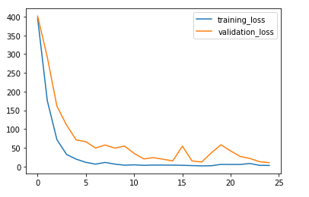
Optimal hyperparameters:
batch size=64,
optimizer= Adam,
learning rate = 0.0005,
epochs = 25,
triplet loss margin = 500
Padmaja
Batch Size | Epochs | Model | Optimizer | kernel_initializer | Triplet Loss Margin | Training Loss | Validation Loss
64 | 15 | C64-BN-MP-C128-BN-MP-DR0.2-C256-BNMP-DR0.2-C256-BN-MP-F-D1024 | Adam(0.0005) | he_normal | 500 | 0.0874 | 5.9374
64 | 20 | C64-BN-MP-C128-BN-MP-DR0.2-C256-BN-MP-DR0.2-C256-BN-MP-F-D1024 | Adam(0.0005) | he_normal | 500 | 0.0703 | 4.2467
64 | 25 | C64-BN-MP-C128-BN-MP-DR0.2-C256-BN-MP-DR0.2-C256-BN-MP-F-D1024 | Adam(0.0005) | he_normal | 500 | 0.0464 | 3.6856

Slide 16
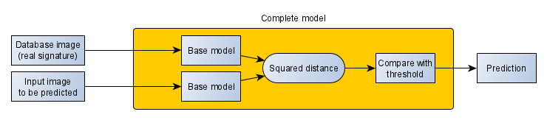
Model Evaluation
Loaded data using csv files available in kaggle.
Model takes two inputs, one real, another could be real or forged. Predicts the second image as either real or forged.

Slide 17
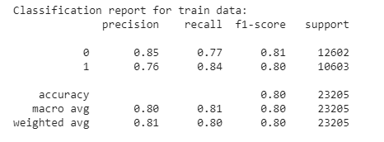
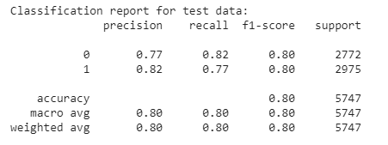
Accuracy of training data : 80.25
Accuracy of testing data : 79.95
Classification report of training data
Classification report of testing data

Slide 18
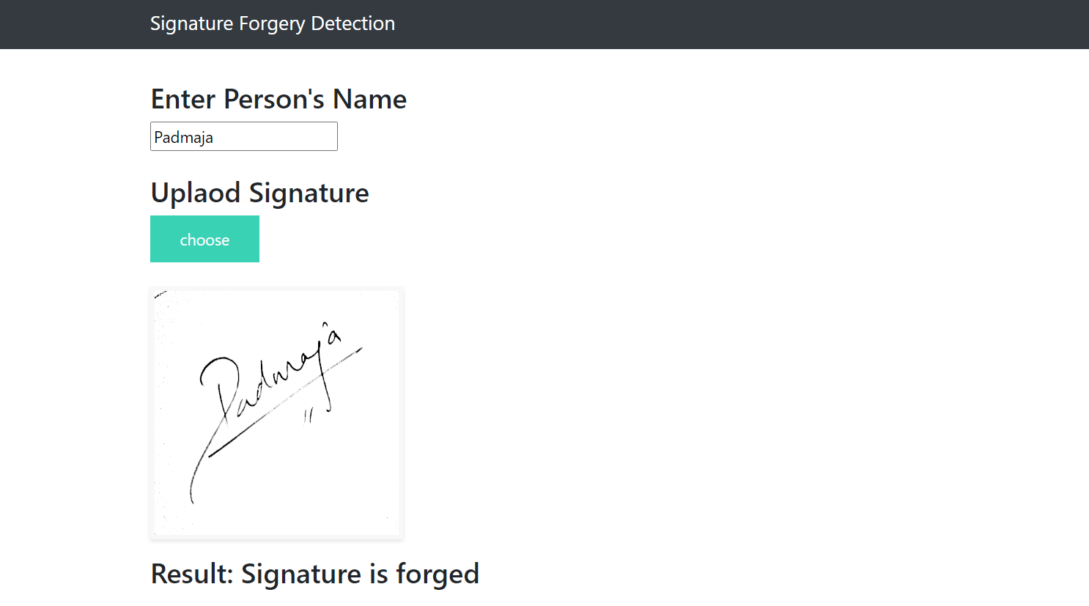
Inference
Web application using flask, html.
Person’s real signature should be present in the database for the model to verify.

Slide 19
Why not use vanilla CNN?
Each person will have two classes: real and forged.
Requires lot of data to train - complexity increases.
Cannot perform on unseen data.

Slide 20
Conclusion
Training using very less data.
Can perform well on unseen data.
Easy to deploy in any work environment.
Can be used as a biometric as well.

Slide 21
References
Kaggle dataset : https://www.kaggle.com/robinreni/signature-verification-dataset
Dataset after reorganization : https://www.dropbox.com/s/ee5rwju5qnlrxb4/sign_data_2.zip?dl=0
Signature Verification using a "Siamese" Time Delay Neural Network :
https://proceedings.neurips.cc/paper/1993/file/288cc0ff022877bd3df94bc9360b9c5d-Paper.pdf
FaceNet: A Unified Embedding for Face Recognition and Clustering : https://arxiv.org/abs/1503.03832
How to choose your loss when designing a Siamese Neural Net : https://towardsdatascience.com/how-to-choose-your-loss-when-designing-asiamese-neural-net-contrastive-triplet-or-quadruplet-ecba11944ec
Siamese Network Keras for Image and Text similarity -
https://medium.com/@prabhnoor0212/siamese-network-keras-31a3a8f37d04

Slide 22
Thank You

